Slide 1
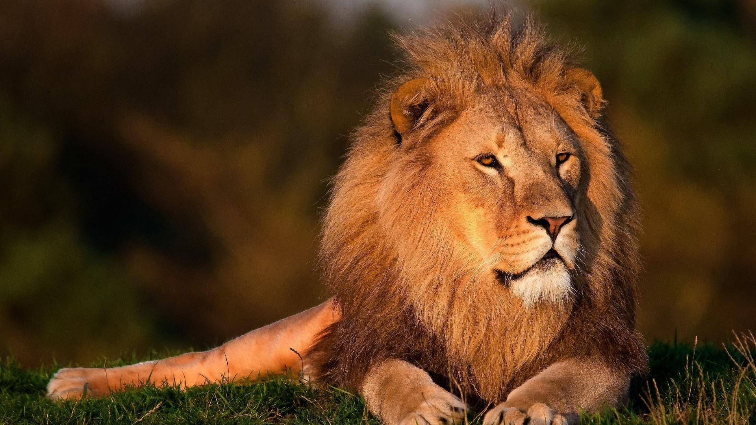
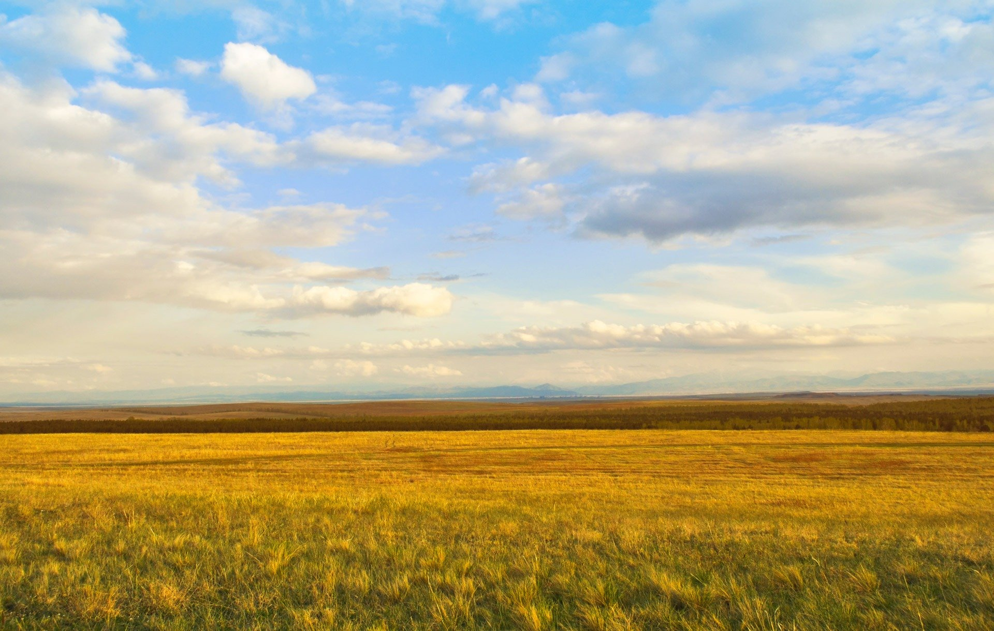


EXPLORING
HABITATS
a science presentation on the different types of habitats and the organisms that live on them
SEN Power project 2022-1-BG01-KA220-SCH-00085065

Slide 2
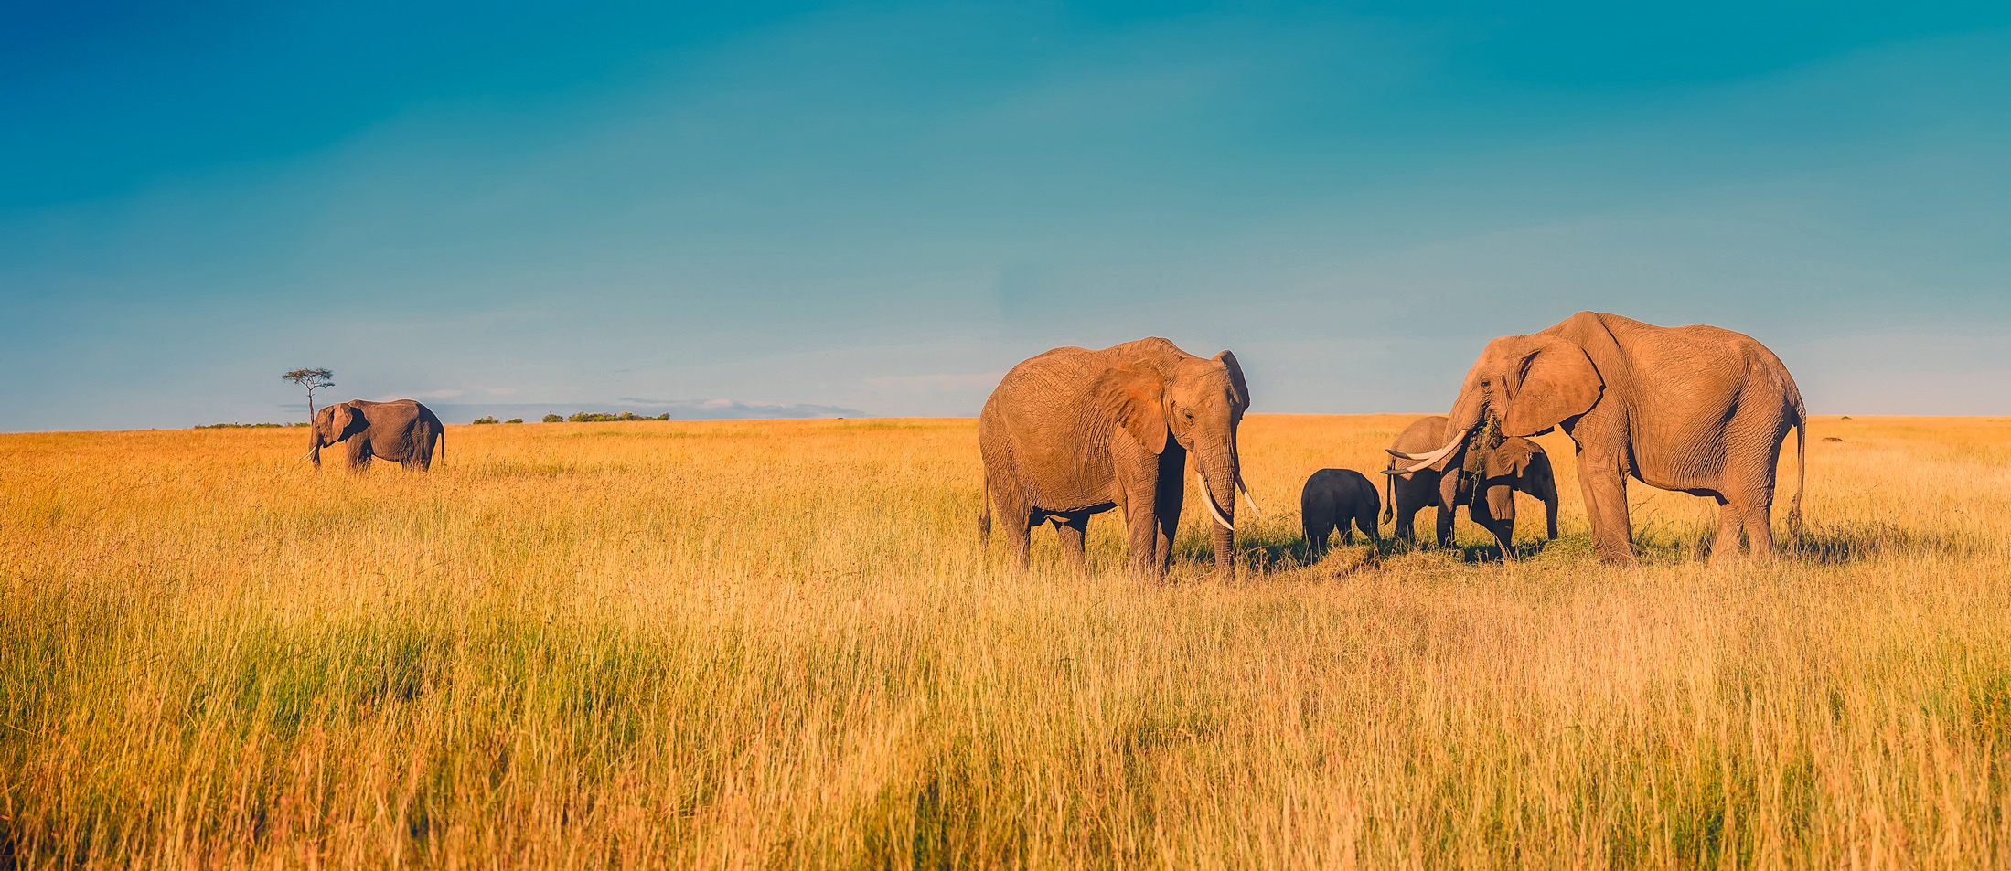
HABITAT
A habitat is a place where plants and animals live. It is a place where they find everything they need to survive, such as food, water, and shelter.

Slide 3
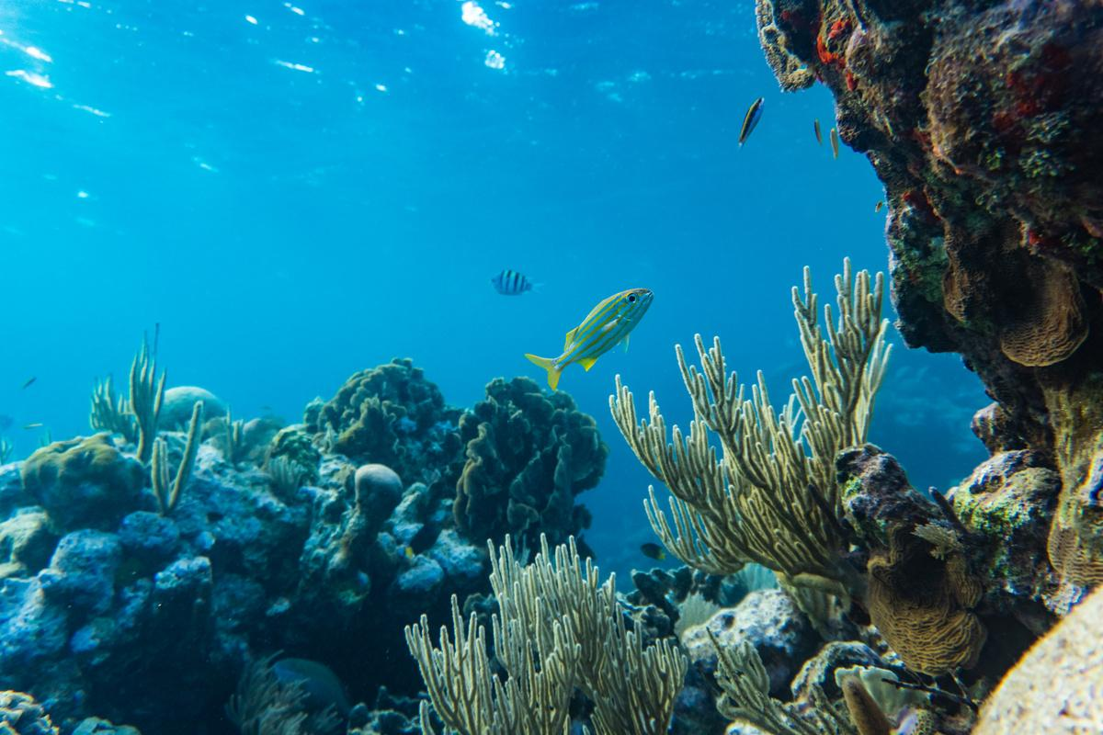
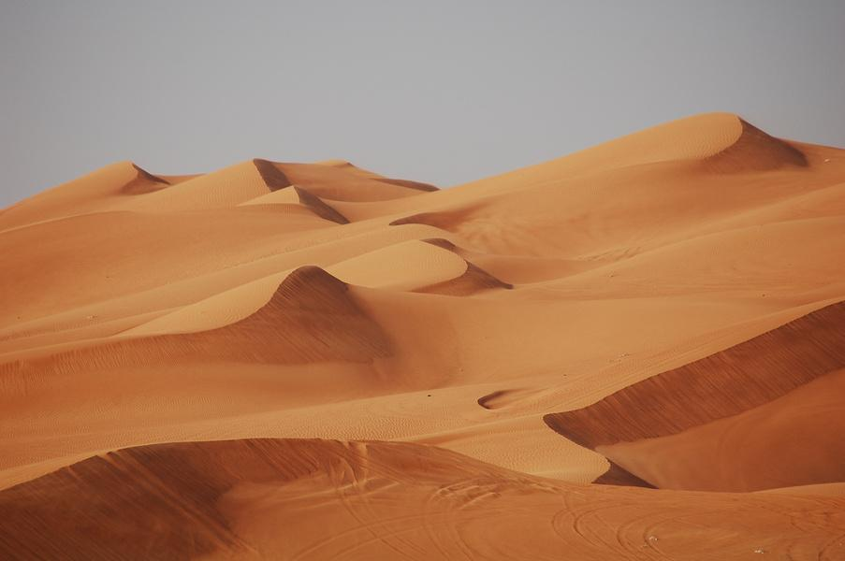
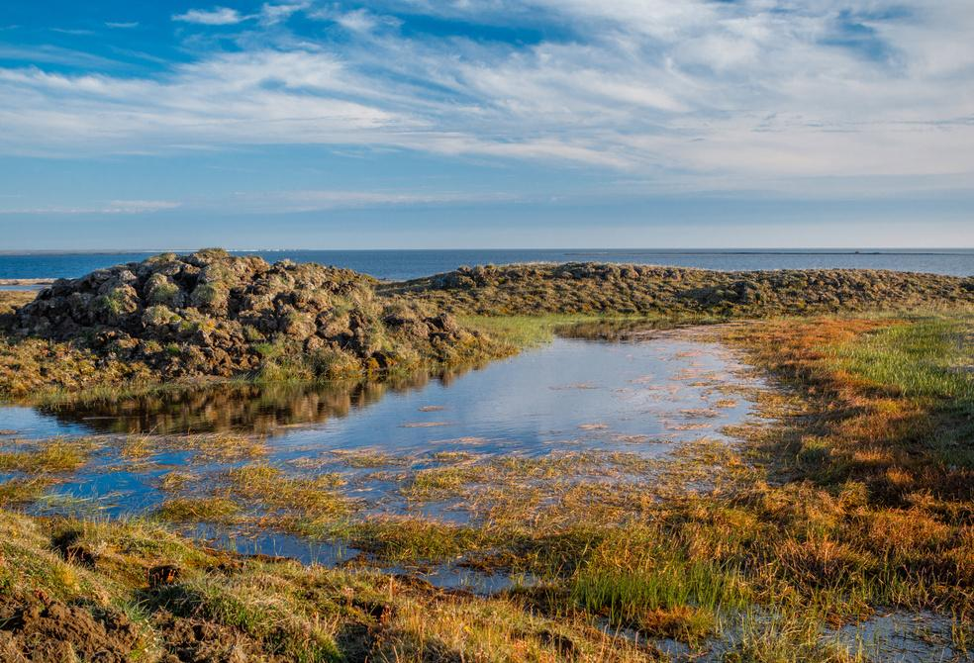
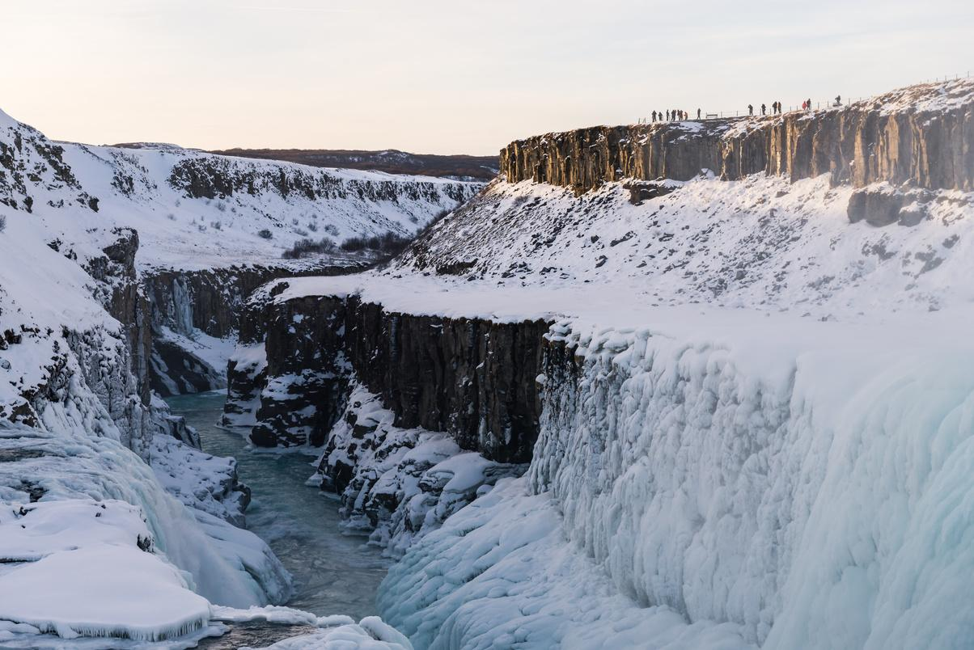
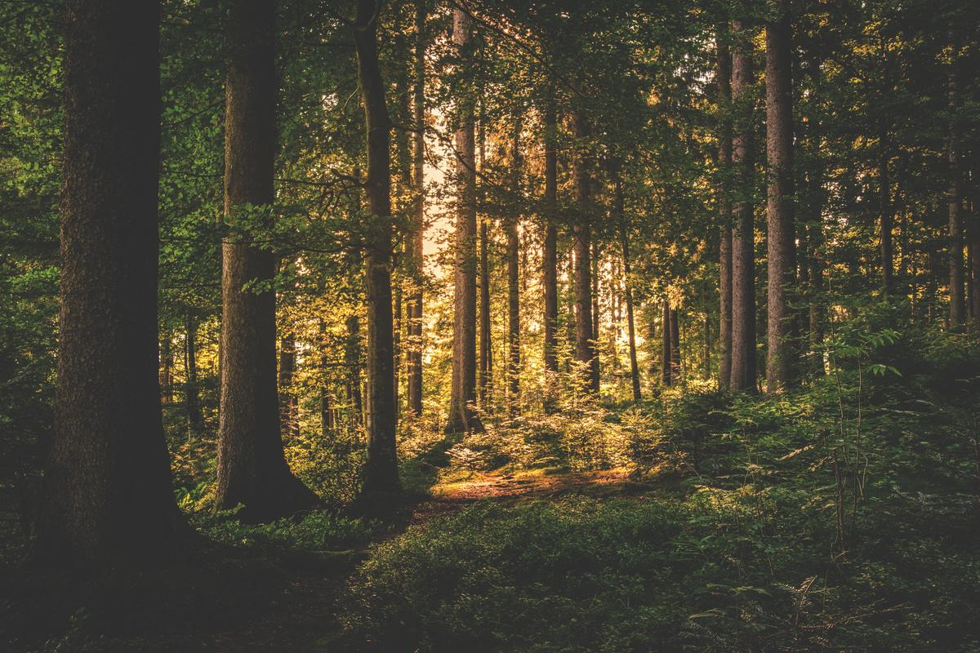
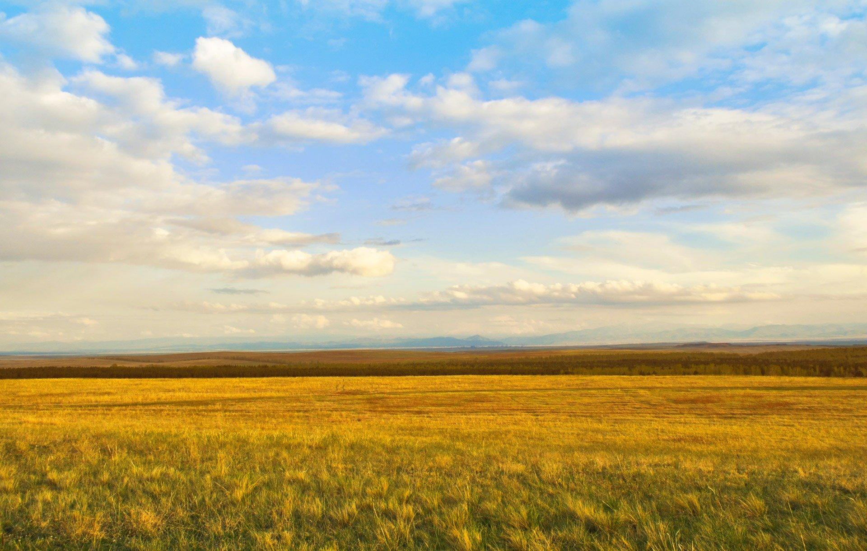
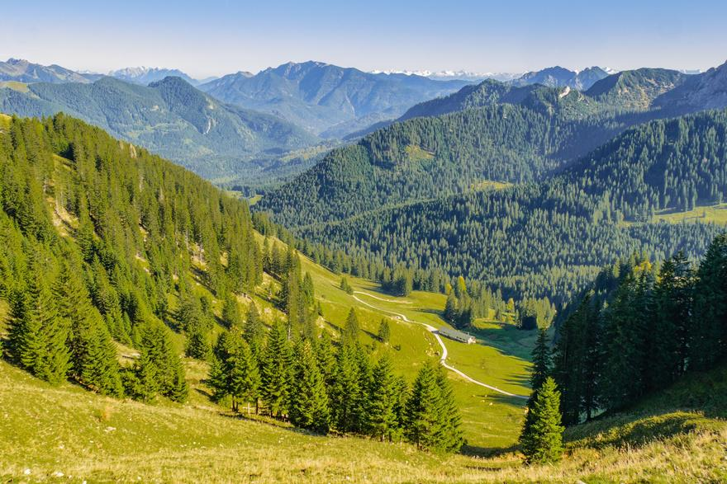
TYPES OF HABITATS
There are various types of habitats on our planet. Each habitat has distinctive characteristics that provide a unique home for a diverse array of plants and animals.
Ocean
Desert
Wetland
Polar Region
Forest
Grassland
Mountain

Slide 4
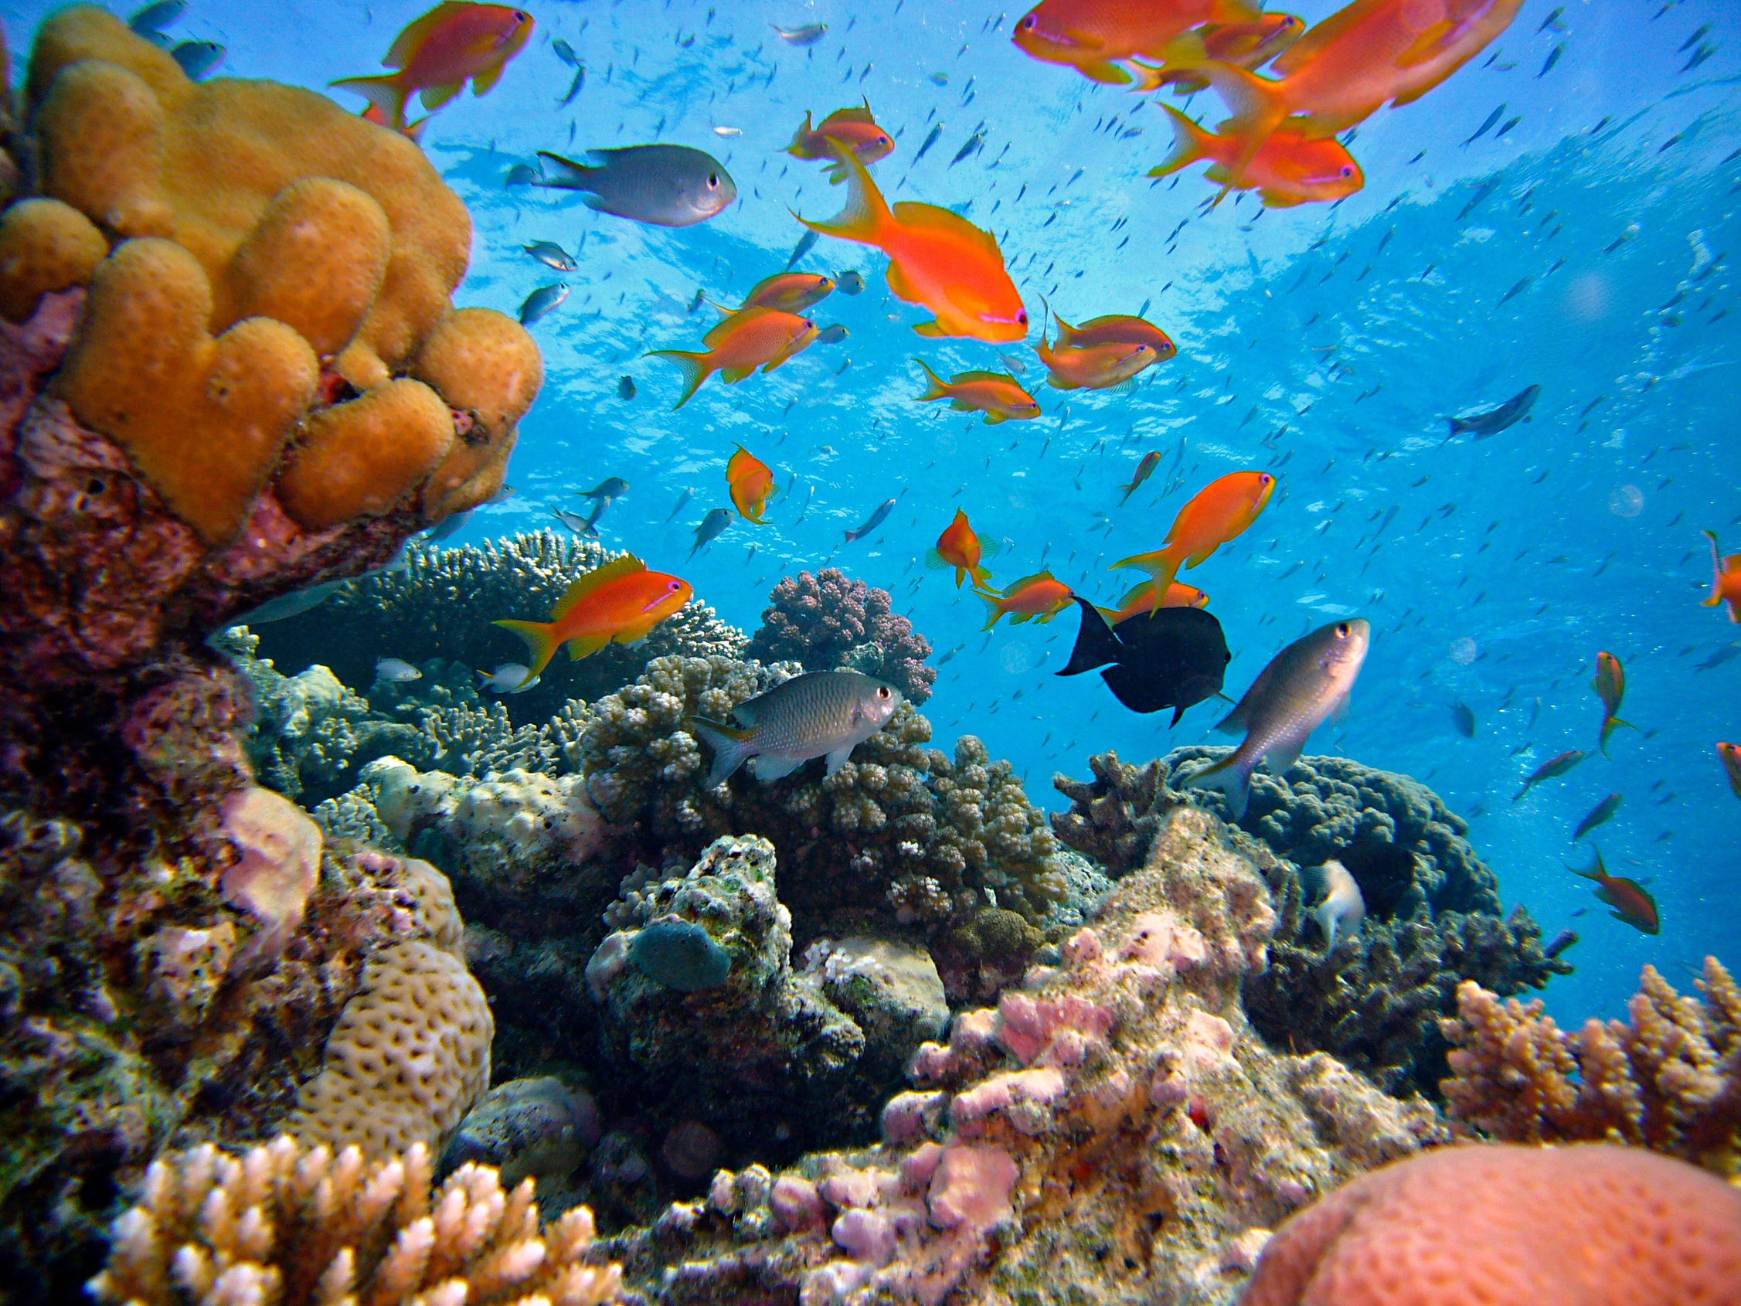
OCEANS
Oceans are vast bodies of saltwater that cover most of the Earth's surface. They are home to an incredible diversity of marine life like kelp, seaweed, fish, sea turtles, crustaceans, dolphins, whales, sharks, and corals.

Slide 5
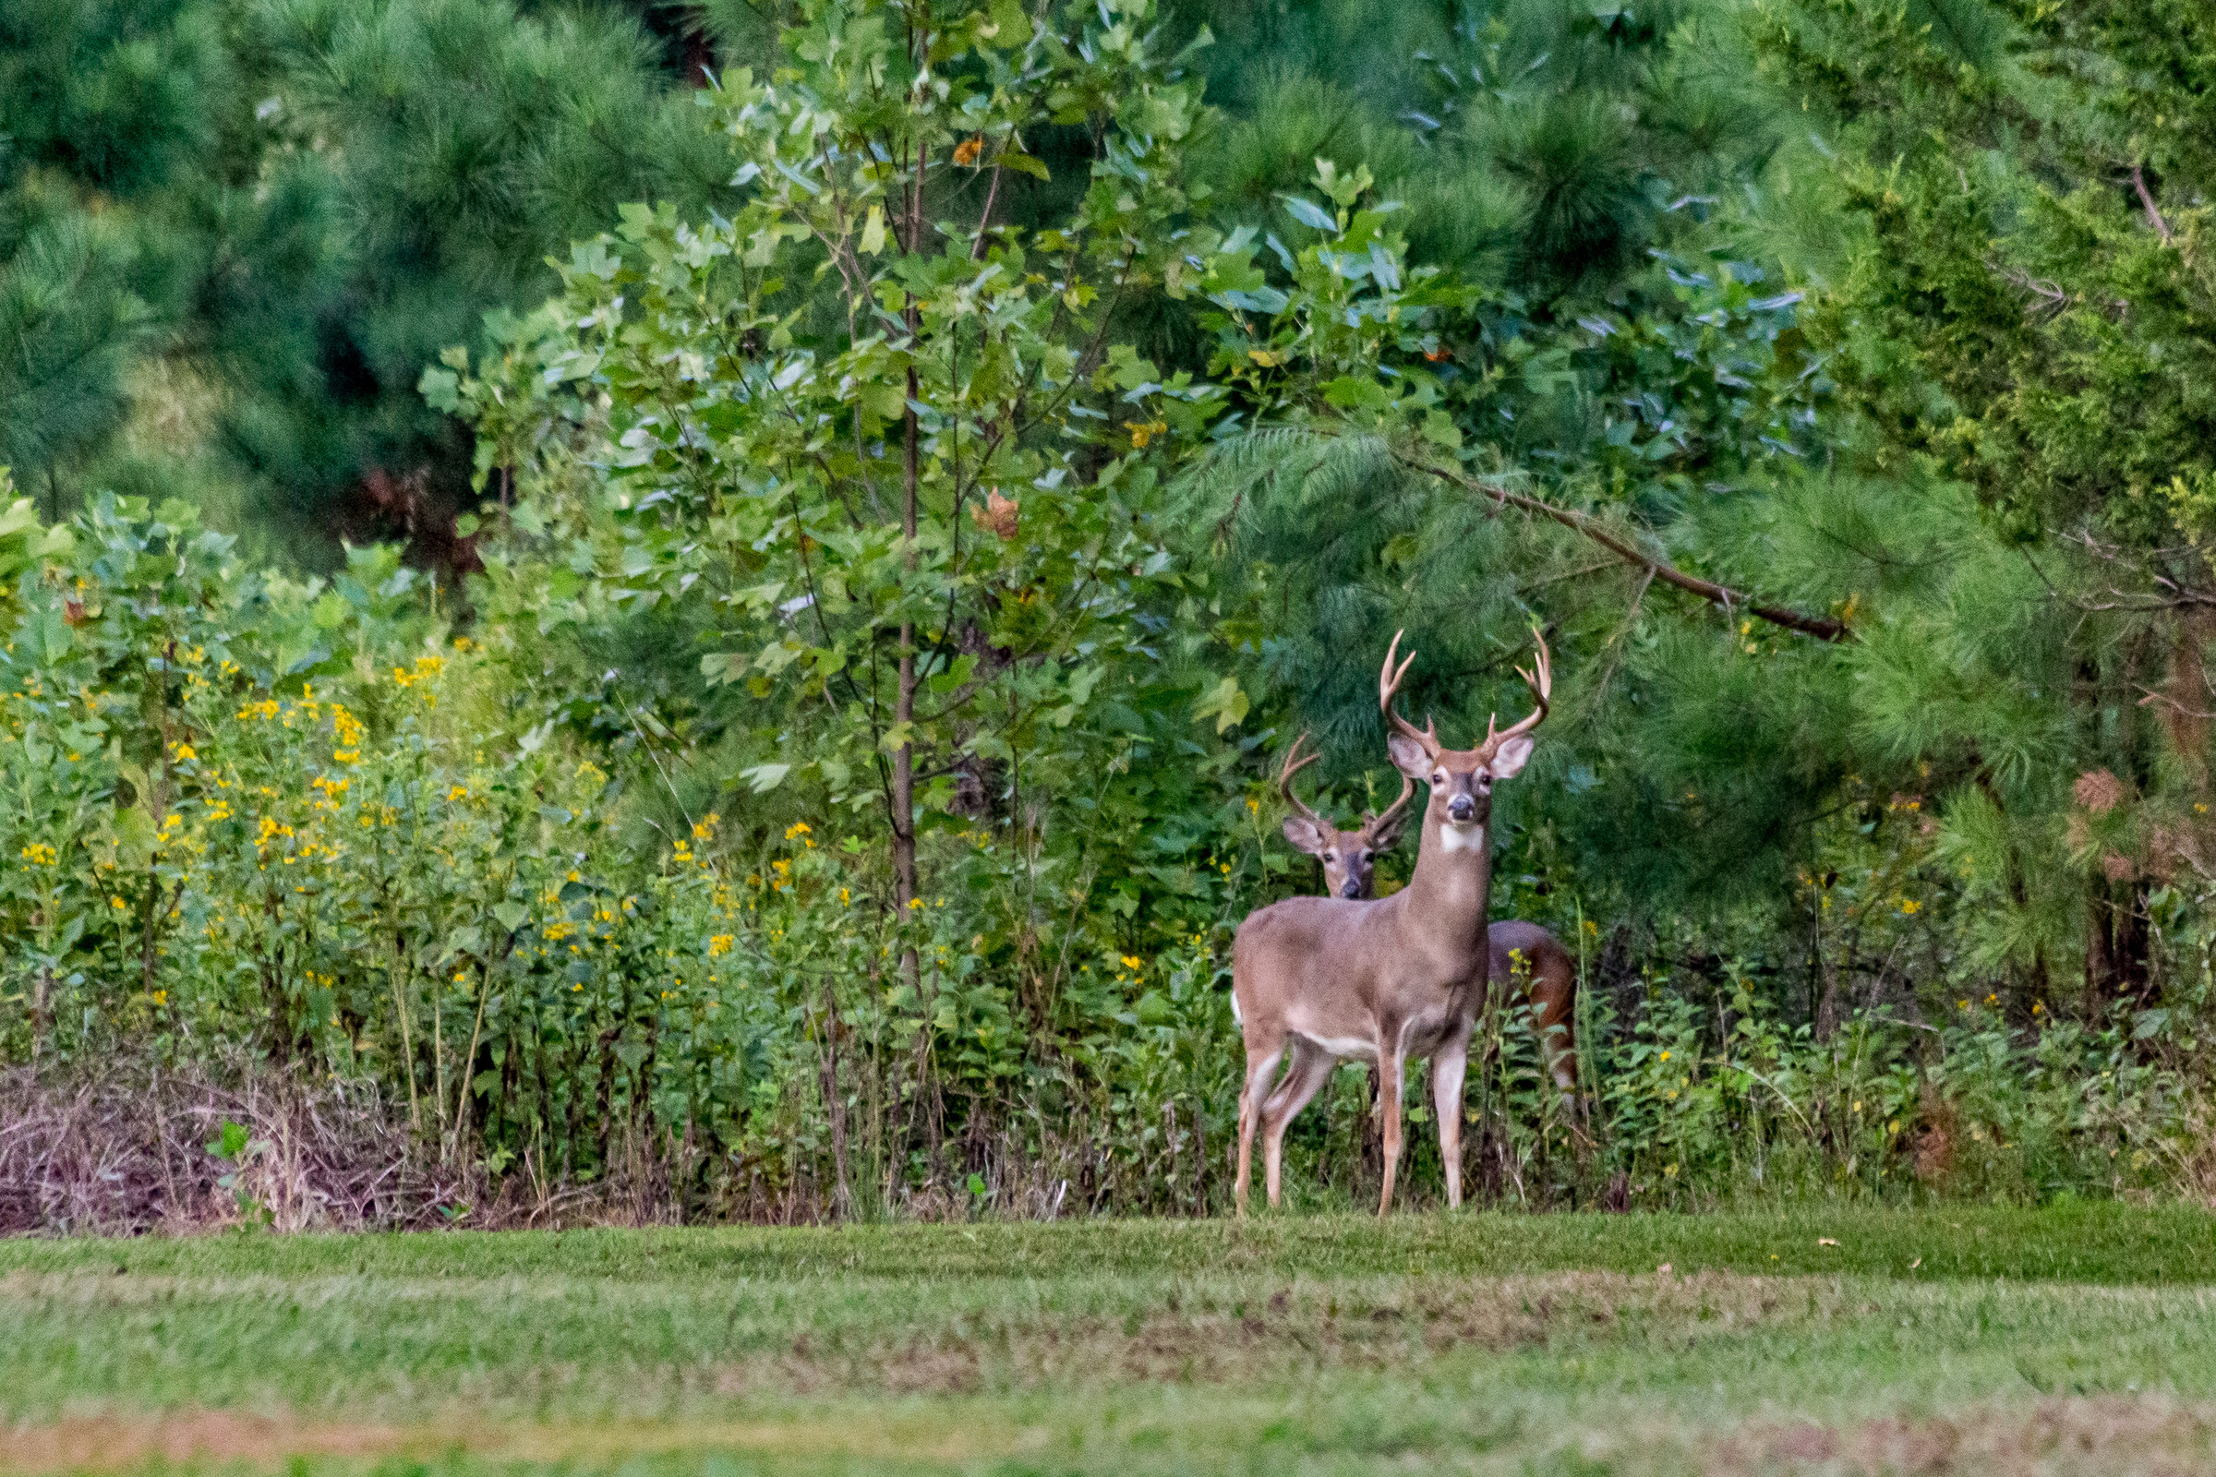
FORESTS
Forests are vast areas filled with many trees. They can be found in different parts of the world and are home to a diverse range of organisms like oak, pine, squirrels, deer, bears, and birds. Forest floors are often covered with plants like ferns and mosses.

Slide 6
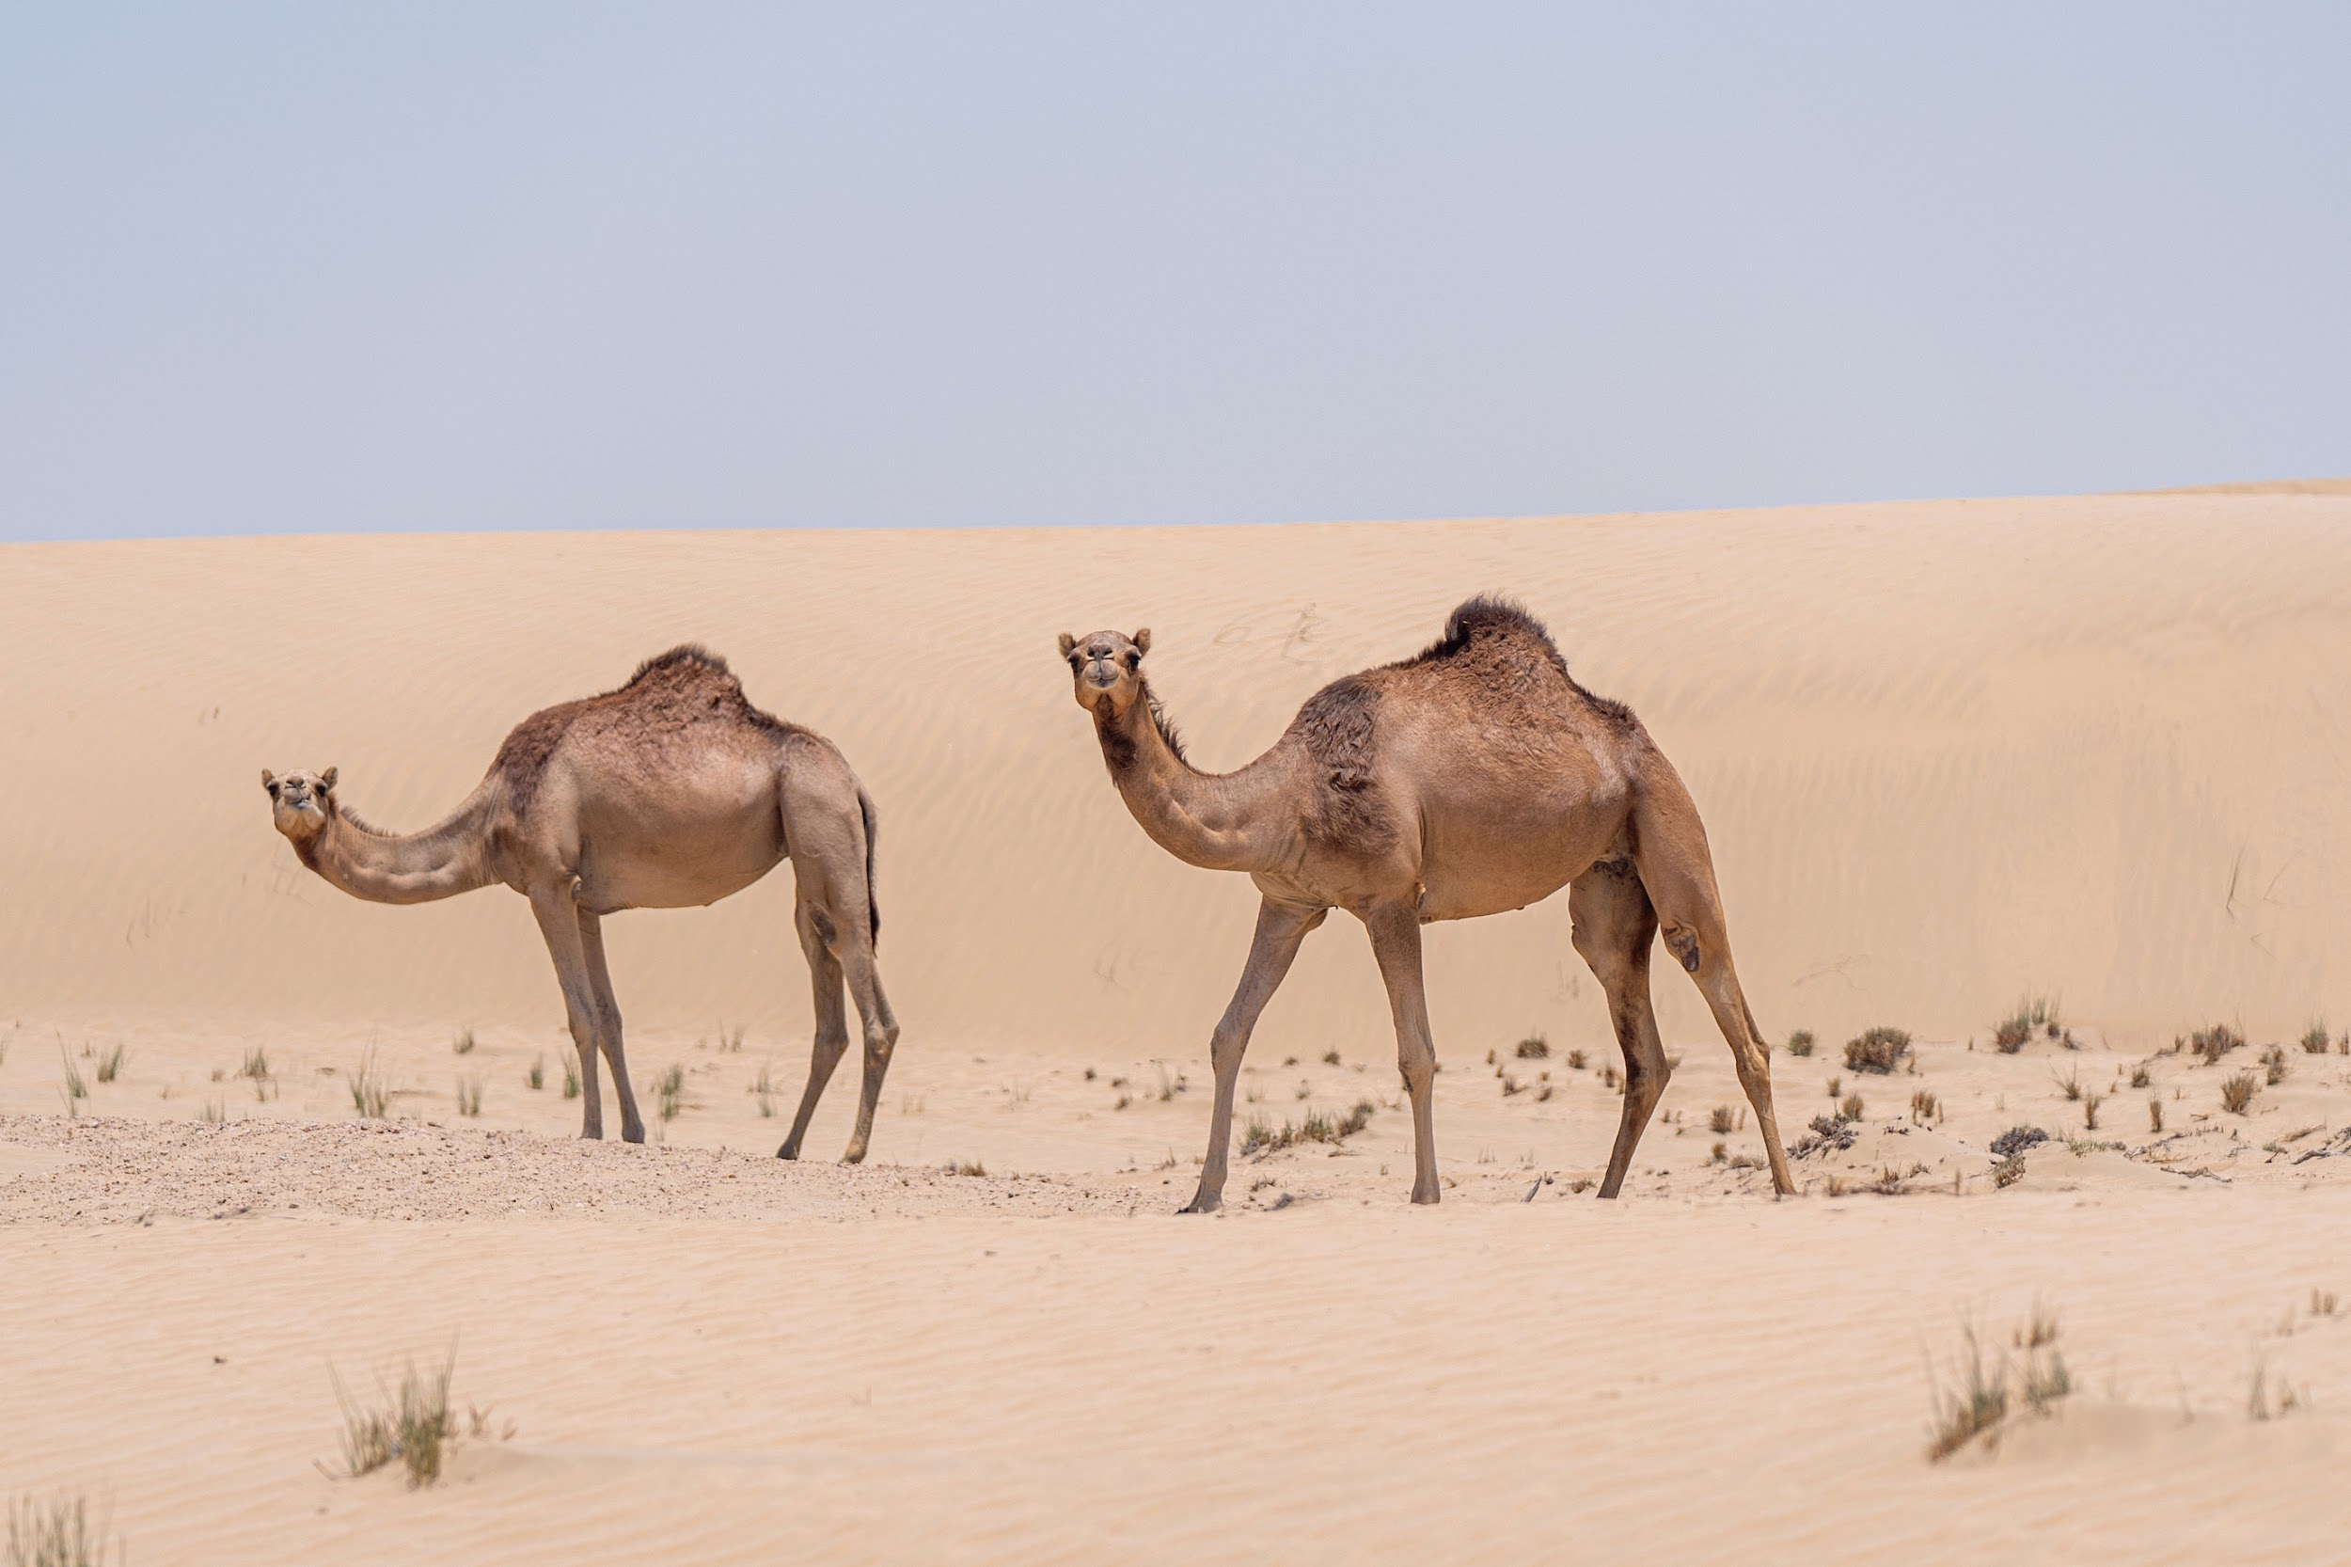
DESERTS
Deserts are dry and hot regions where there is very little rainfall. These habitats can be sandy or rocky and have extreme temperature variations. Desert plants, like cacti and succulents, have special adaptations to conserve water. Animals such as camels, snakes, scorpions, and lizards are well-suited to survive in deserts.

Slide 7
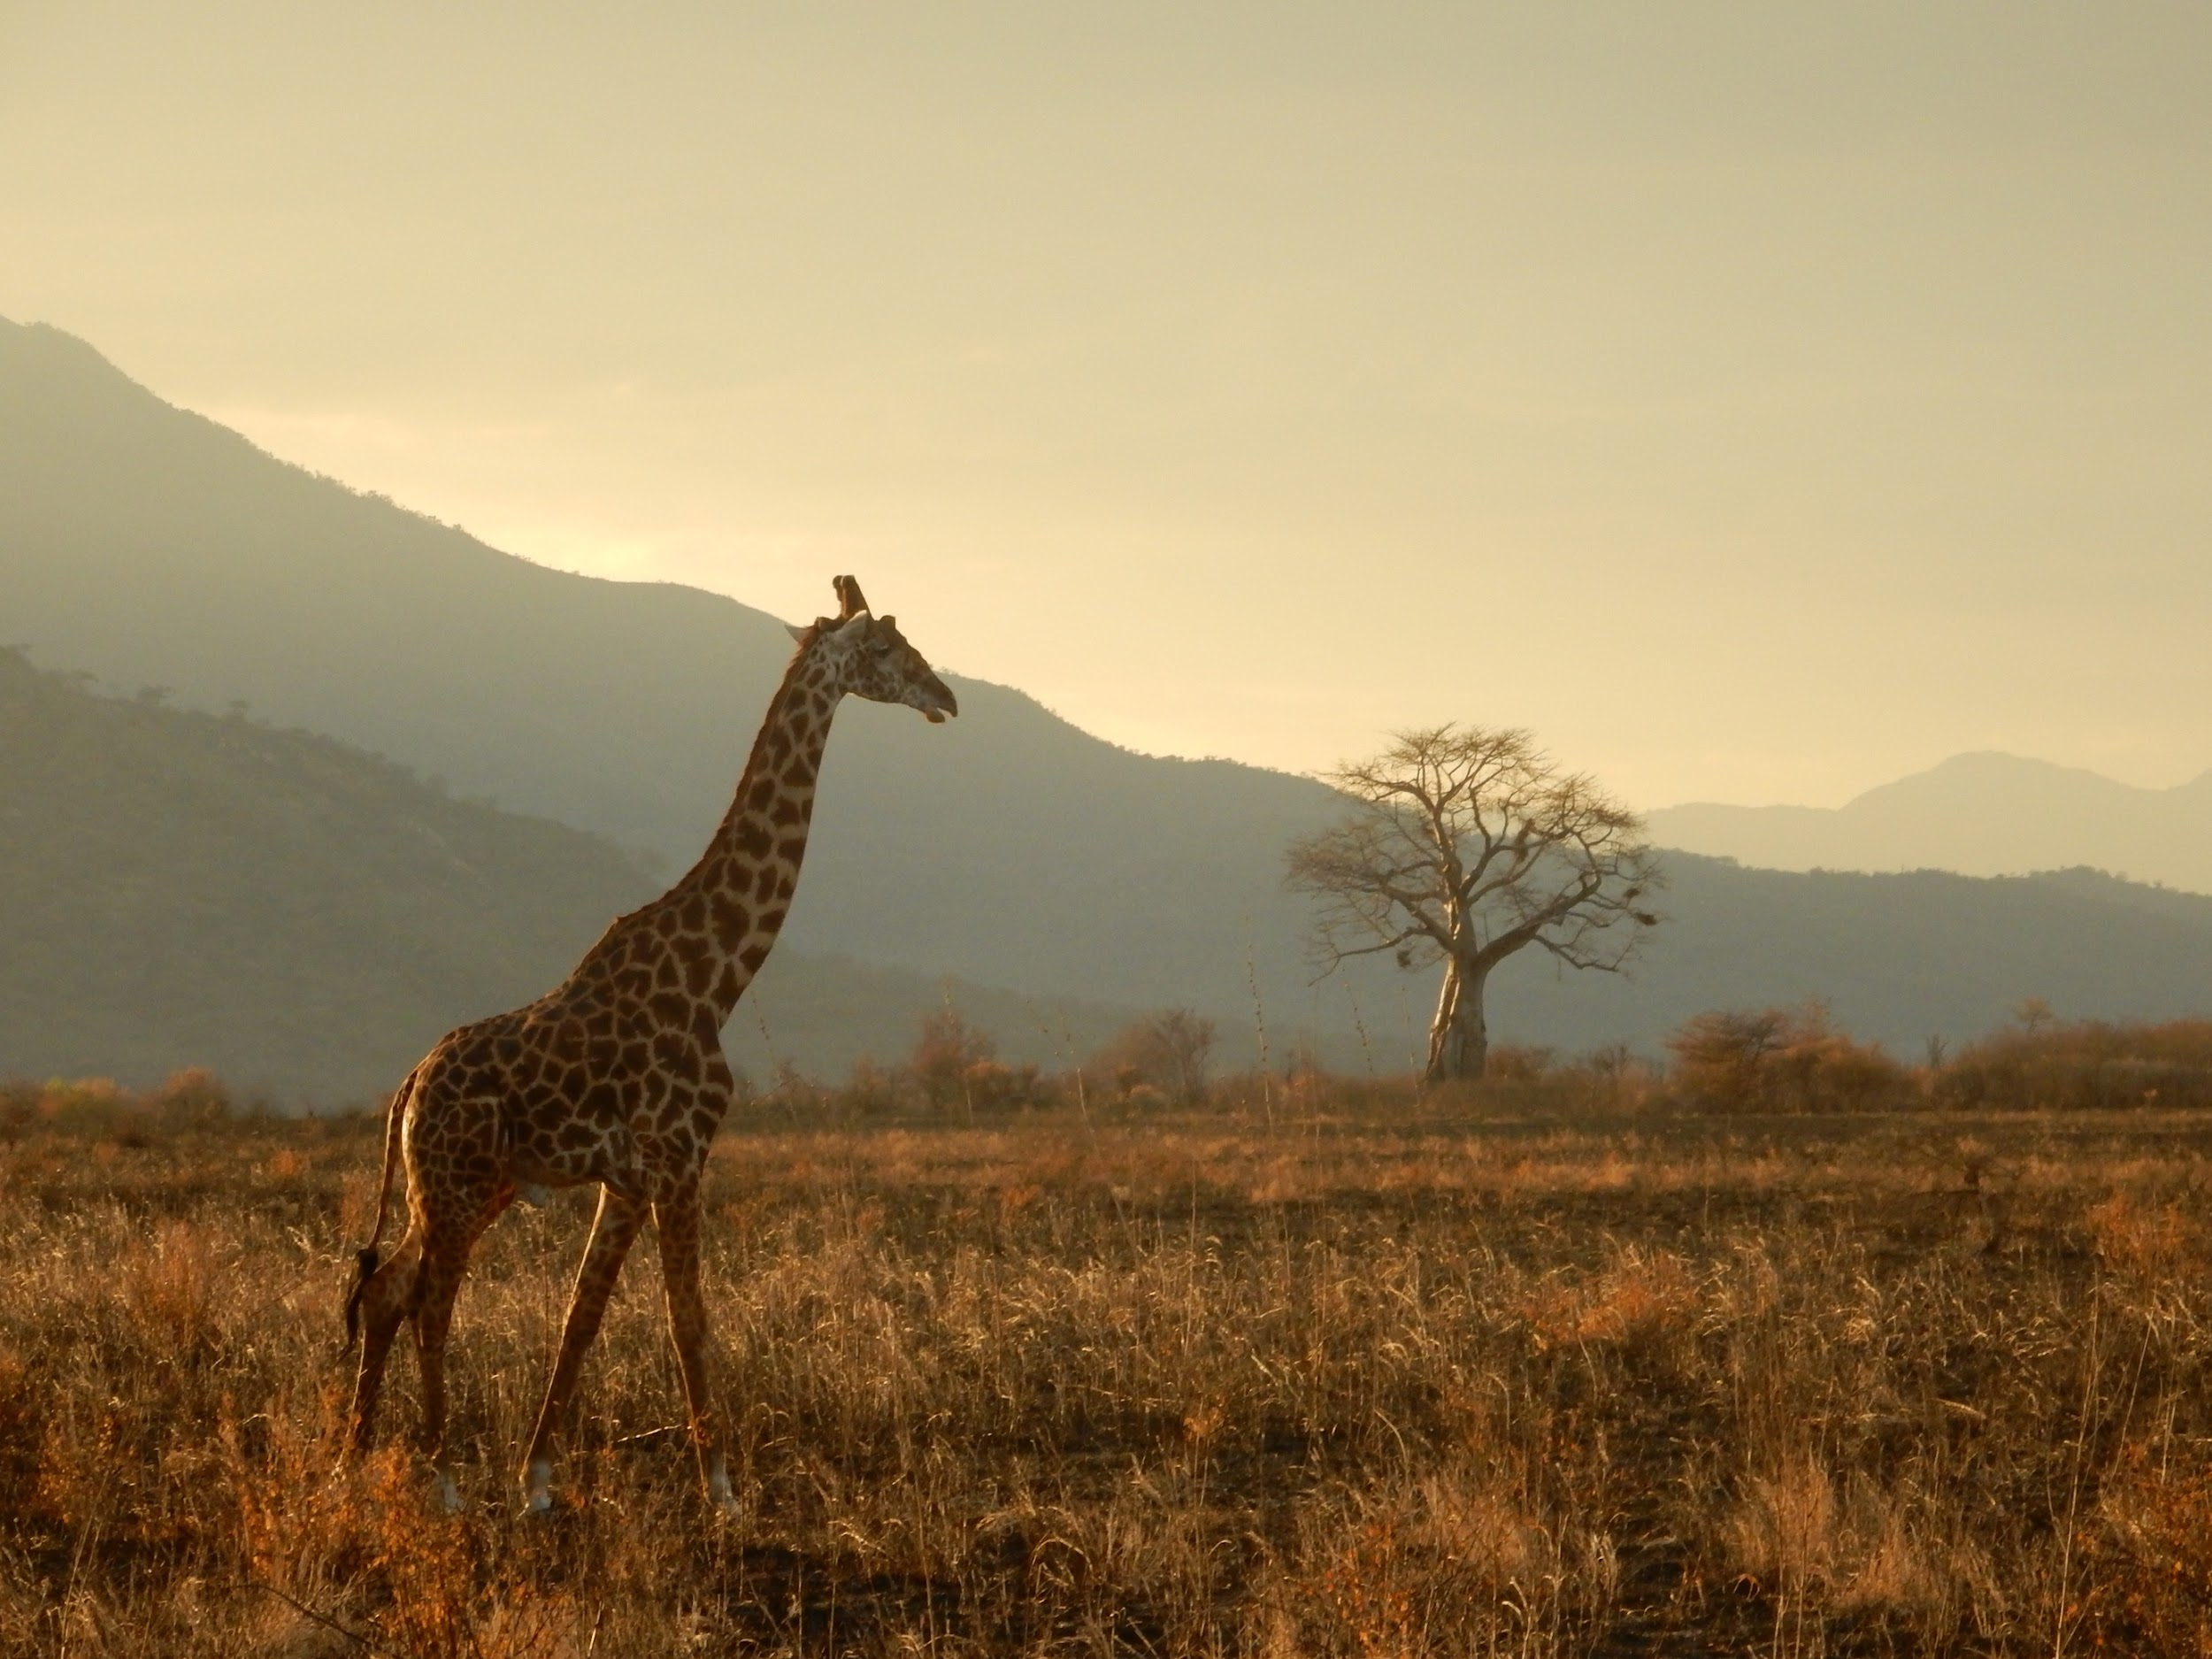
GRASSLANDS
  Grasslands are wide open spaces covered with grasses and few or no trees. They can be found in different parts of the world, including the prairies of North America and the savannas of Africa. Grasslands are home to animals like bison, zebras, giraffes, and grazing animals. Predators like lions and cheetahs also inhabit these areas.

Slide 8
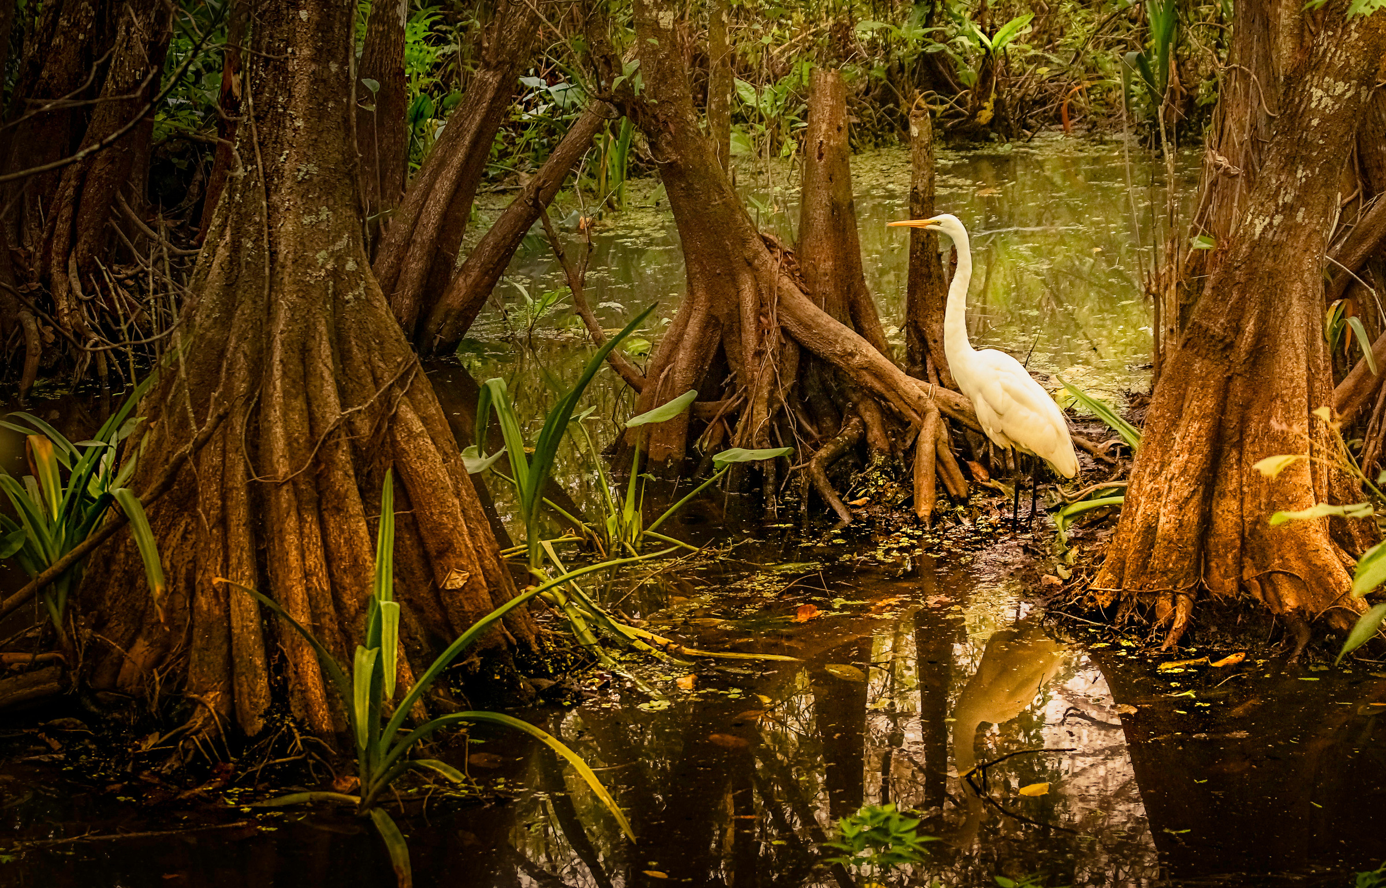
WETLANDS
  Wetlands are areas where the land is saturated with water for a significant part of the year. They include marshes, swamps, and bogs. Wetlands are crucial for maintaining water quality and providing habitats for many species. Cattails, water lilies, ducks, frogs, alligators, and various bird species depend on wetlands for food and shelter.

Slide 9
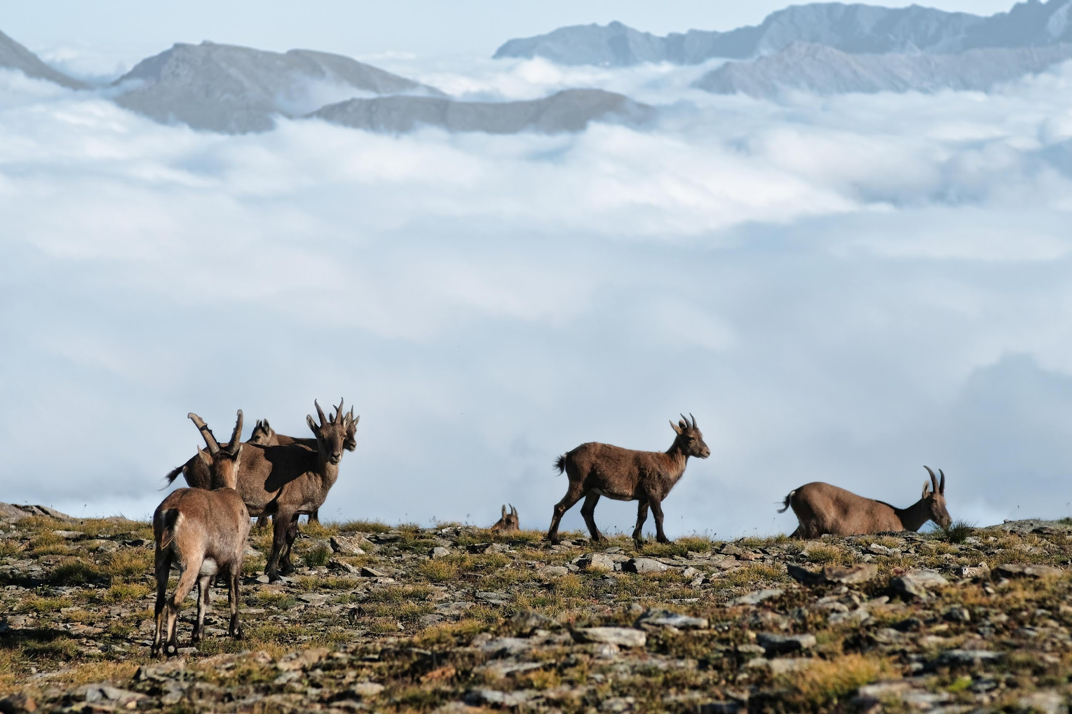
MOUNTAINS
  Mountains are habitats characterized by steep slopes, high altitude, and colder temperatures as you climb higher. They are home to unique plant and animal species adapted to survive in harsh conditions. Animals like mountain goats, snow leopards, and eagles can be found in mountainous regions.

Slide 10
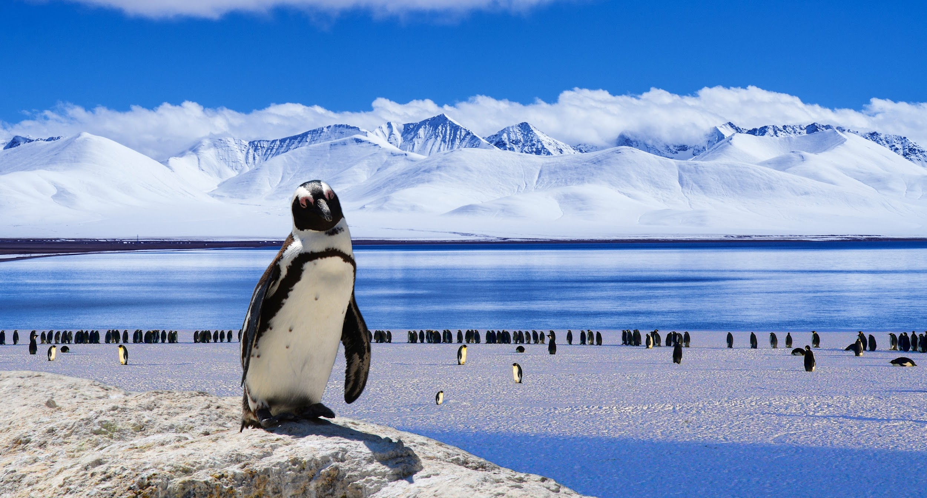
POLAR REGIONS
The polar regions include the Arctic at the North Pole and the Antarctic at the South Pole. These habitats are extremely cold, covered in ice and snow for much of the year. Polar bears, penguins, seals, and various seabirds are adapted to survive in these icy environments.

Slide 11
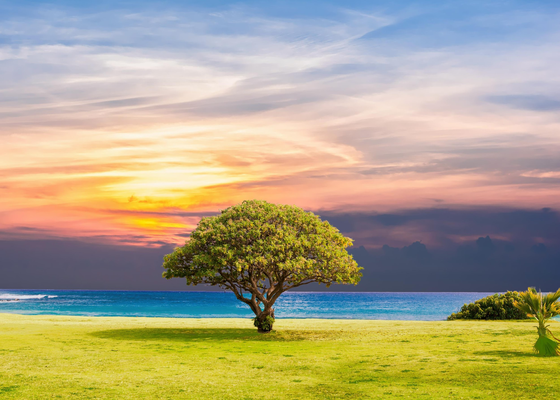


THANK
YOU!

Slide 12







2022-1-BG01-KA220-SCH-000085065
School subject: Natural Science
Students’Age: 10 years
Topic: Exploring Habitats
Credits: Antalya Directorate Of Education
All media are within the EU intellectual property law.
The European Commission’s support for this publication does not constitute an endorsement of the contents, which reflect the views only of the authors, and the Commission cannot be held responsible for any use which may be made of the information contained herein.

